Slide 1
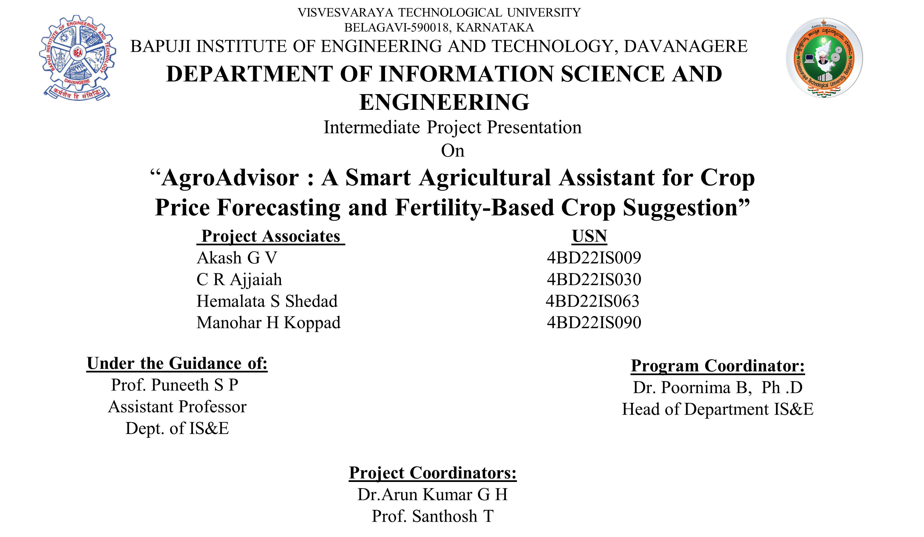
Project Phase II Presentation

Slide 2

CONTENTS
01.
Abstract
07.
Testing
Introduction
02.
08.
Results and Discussion
03.
Literature Survey
Conclusion
09.
04.
System Requirements and Specifications
10.
Future Enhancements
05.
11.
References
System Design
06.
Implementation

Slide 3
ABSTRACT
AgroAdvisor is an intelligent assistant that empowers farmers with machine learning-driven insights. It forecasts crop prices using time-series models trained on historical trends for better market planning. The system also recommends suitable crops by analyzing soil fertility (pH, nitrogen, phosphorous, potassium), regional, and climatic data. Using machine learning algorithms, AgroAdvisor delivers accurate, data-informed decisions to boost agricultural productivity and profitability.

Slide 4

INTRODUCTION
Agriculture plays a vital role in India’s economy, yet farmers continue to face challenges such as price volatility and ineffective crop planning due to the lack of predictive tools in traditional practices. AgroAdvisor addresses these issues by using machine learning algorithms to forecast crop prices and by recommending crops based on soil fertility and regional data. By empowering farmers with AI-driven insights, the system enhances decision-making, increases crop yield, and boosts overall profitability, effectively bridging the gap between agriculture and technology.

Slide 5
PROBLEM STATEMENT
Farmers in India struggle with unpredictable crop prices and lack reliable, personalized crop guidance. Existing tools offer only real-time data and generic recommendations. This results in poor crop planning and reduced profitability. A smart system is needed that forecasts prices and suggests crops based on soil and regional data. AgroAdvisor fills this gap using Machine learning models. It enables informed, data-driven farming decisions for better outcomes.

Slide 6
OBJECTIVES
To develop an intelligent system that predicts crop prices based on historical data and seasonal trends using machine learning techniques.
To analyze soil fertility parameters and recommend the most suitable crops for upcoming cultivation cycles.
To build and integrate a yield prediction model to forecast potential output and enhance crop selection.
To promote the adoption of AI in agriculture by providing a practical, accessible solution tailored to the needs of rural farmers.

Slide 7
Existing System
Most farmers in India and other developing countries still depend on traditional knowledge or local advice for crop and market decisions. Existing platforms provide soil tests, prices, or weather updates but lack intelligent forecasting, region-specific insights, and user-friendly access. The absence of an integrated, personalized, and easy-to-use system leads to poor decisions, inefficient resource use, and lower profits.
Proposed system
AgroAdvisor is a smart, ML-powered assistant that provides three key insights: crop price forecasting, fertility-based crop recommendation, and potential yield prediction. It predicts future prices using historical trends, while analyzing soil nutrients and environmental factors to suggest the most suitable and profitable crops. With a simple web interface that accepts farmer-provided soil data, it enables data-driven farming decisions for all scales of farmers.

Slide 8
LITERATURE SURVEY
Crop Recommendation System Using Machine Learning | M. S. Joshi, et al. (2022) | Compares ML models and finds Random Forest is highly effective for soil-based crop recommendation | Focuses only on crop recommendation. Does not integrate price or yield
Crop Price Prediction using Machine Learning Techniques | A. Wahdan, et al. (2021) | Compares models for price forecasting and shows Gradient Boosting is a top performer | Focuses only on price. Is not connected to soil data or crop suitability
Crop Yield Prediction Using Random Forest Algorithm for Major Cities | K. Moraye, et al. (2021) | Uses Random Forest with climatic parameters to predict crop yield. | Focuses only on yield. Does not recommend suitable crops or predict prices.
Title
Author
Methodology
Gap

Slide 9
System Requirements and Specifications
1. Functional Requirements:
User Management: Users can register, log in, and log out of the system.
ML-Driven Predictions: The system provides three core predictions based on user input (soil, location):
Crop Recommendation (using Random Forest)
Price Prediction (using Gradient Boosting)
Yield Prediction
Farmer Marketplace:
Users can add their produce for sale.
Users can browse products listed by other farmers.
2. Non-Functional Requirements:
The system should provide responses within a few seconds.
Should be scalable to handle increasing user load.
Must be secure and protect user data.
Should have high accuracy in predictions (>85%).`

Slide 10
System Requirements and Specifications
.3. Hardware Requirements
Processor: Intel i5 or higher (development)
RAM: Minimum 8 GB
Storage: Minimum 500 GB (HDD/SSD)
Internet connection for API/data fetching
4. Software Requirements
Frontend: HTML, CSS, JavaScript
Backend: Python (Flask)
Libraries: scikit-learn, pandas, Flask-SQLAlchemy, Flask-Login, Flask-WTF
Database: SQLite
OS: Windows/Linux/Mac

Slide 11
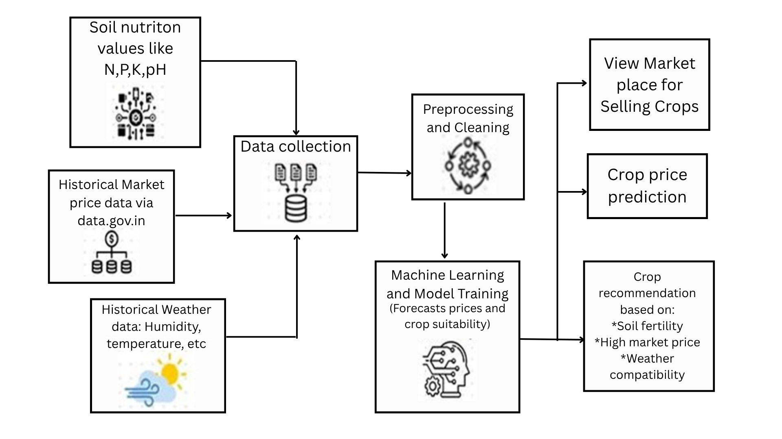
System Architecture

Slide 12
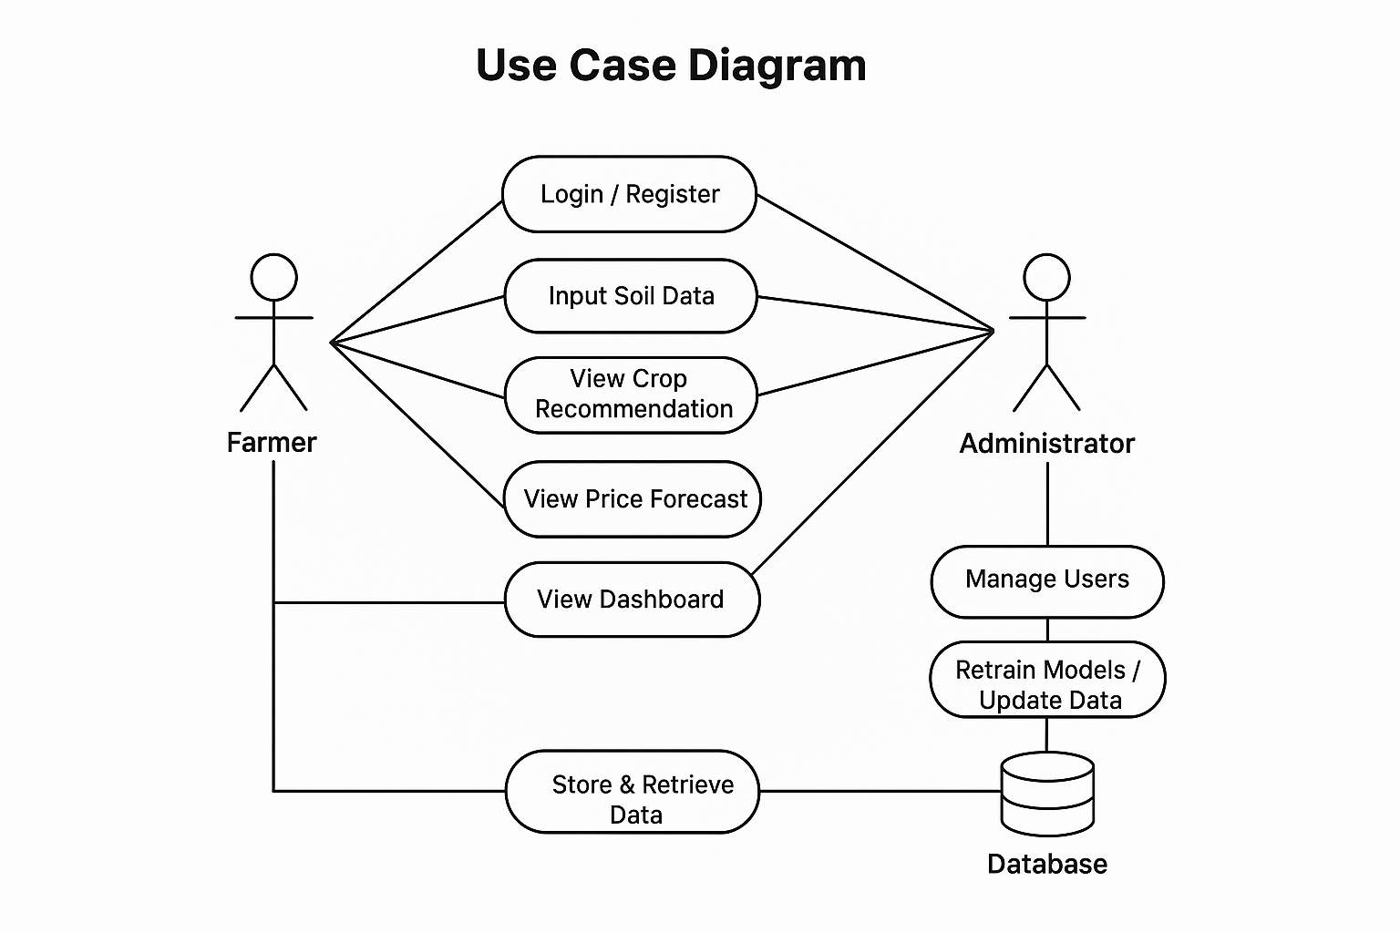
Use Case Diagram

Slide 13
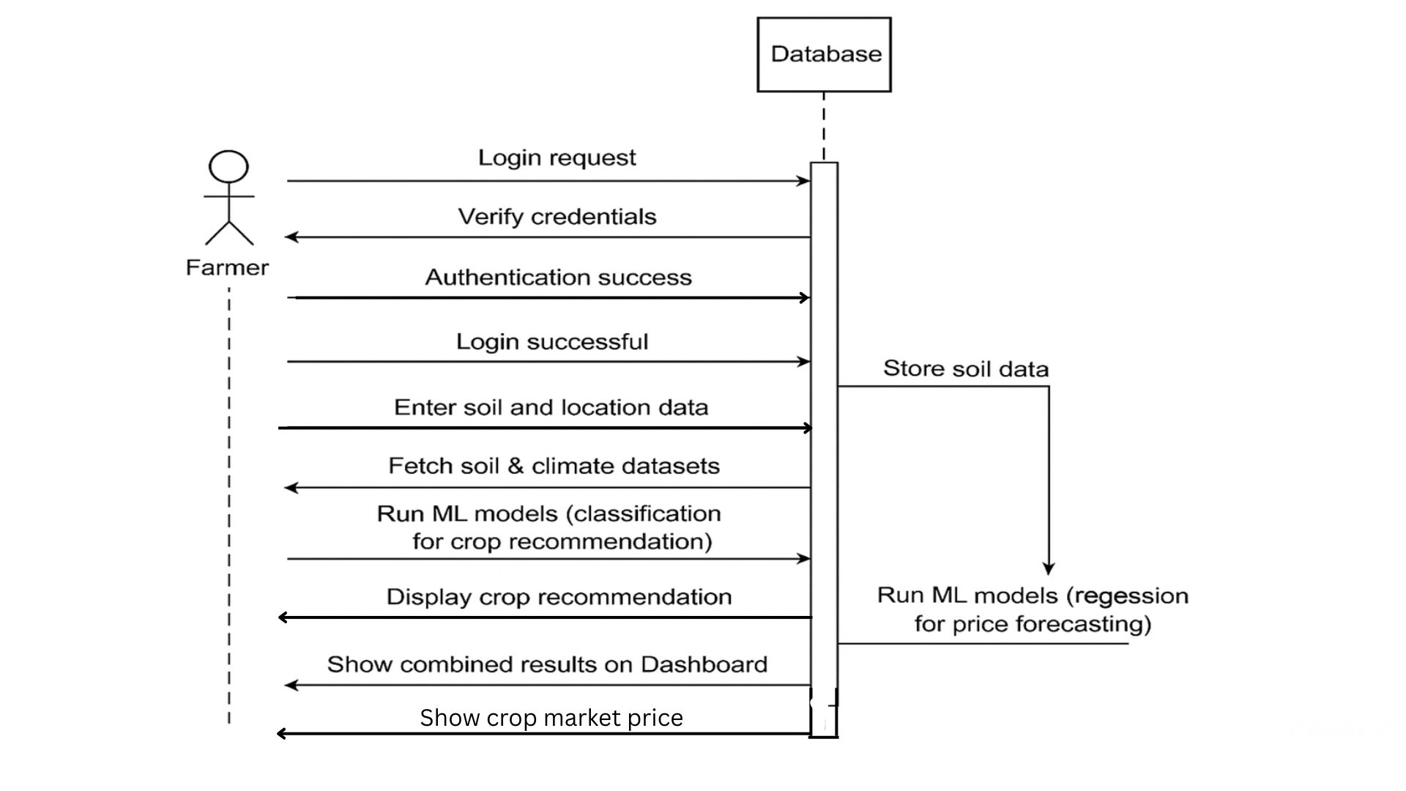
Sequence Diagram

Slide 14
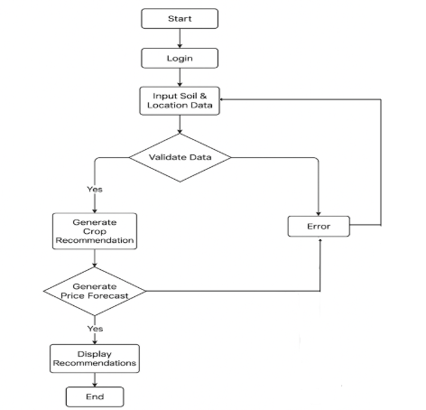
s
Activity diagram

Slide 15
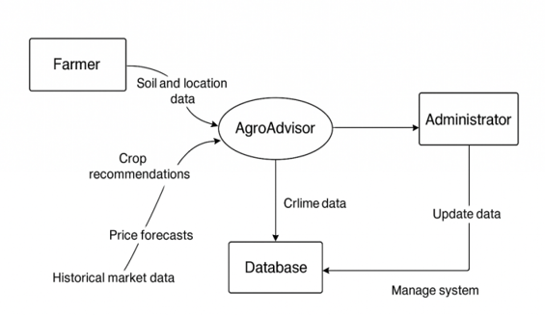
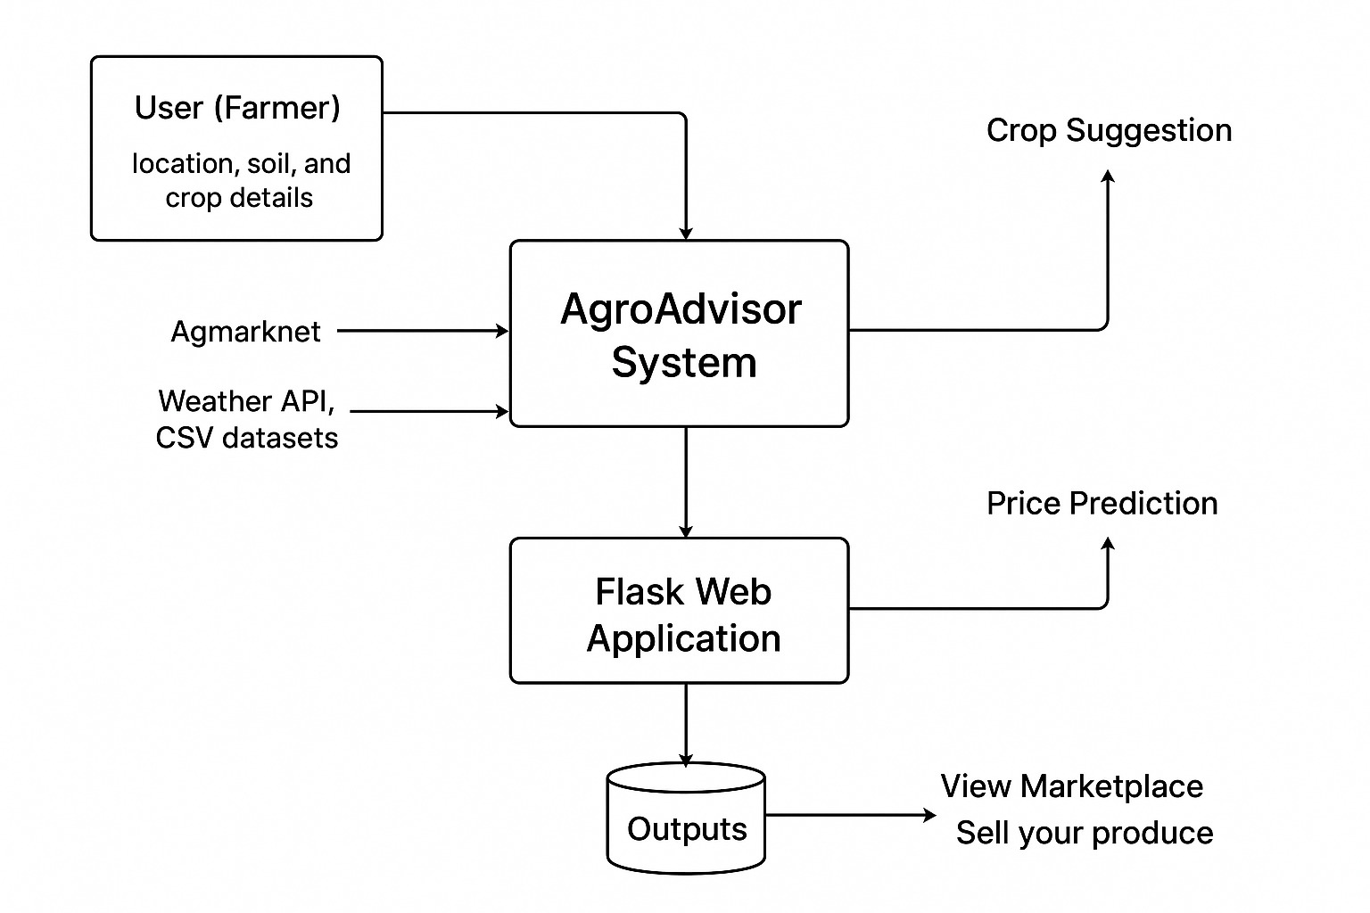
Data Flow Diagram

Slide 16
IMPLEMENTATION
Tools and Technologies Used :
Programming Languages:
Python (For backend logic, data processing, and ML models)
Frameworks & Core Libraries:
Flask (Core web framework for the application)
Flask-SQLAlchemy (Database ORM for users and products)
Flask-Login (Handling user authentication and sessions)
Flask-WTF (Creating and validating web forms)
Data Science & ML Libraries:
Scikit-learn (For building and running the ML models)
Pandas & NumPy (Data handling, cleaning, and preprocessing)

Slide 17
IMPLEMENTATION
Tools and Technologies Used :
Data Sourcing & APIs (For Model Training):
Agmarknet (agmarknet.gov.in) (Used to scrape historical crop market prices)
Open-Meteo API (Used to fetch historical weather data for training)
Database:
SQLite (Application database for user and marketplace data)
ML Models Used:
RandomForestClassifier (For Crop recommendation)
GradientBoostingRegressor (For Price and arrivals Recommendation)
Regression Model (For yield prediction)
IDEs / Tools:
VS Code (development & testing)Postman (API testing)

Slide 18
Project Modules:
Authentication Module (auth):
Handles user registration, login, and logout.
Uses Flask-Login to manage user sessions.
Farmer Dashboard Module (farmer):
This is the core user-facing module
Provides web forms for users to input soil (N, P, K, pH) and location data
Calls the ML models to get predictions and displays the "Top 5 Recommendations“
Prediction Module (Processing Module) :
Uses Gradient Boosting Regressor for price and arrivals.
Trains on cleaned dataset with weather + market features.
Generates price and arrival forecasts for future dates.
Marketplace Module (market):
Allows users to "Sell Your Produce" by adding new products to the database.
Lets users browse a "Marketplace" to see all products listed by other farmers.

Slide 19
Testing
Testing Strategy :
Unit Testing:
Verified helper functions for data formatting).
Verified that all ML models (.joblib files) load correctly
Checked weather API returns valid latitude/longitude and daily values.
Tested individual helper functions and data-formatting logic
Backend Logic Testing (Integration):
Tested that the main route receives the correct soil and location data from the user's form.
Checked that the Crop Recommendation model (recommender.py) is called first and successfully returns a top 5 crop list
Verified that the Price (predictor.py) and Yield (yield_model.joblib) models are called in a loop for each of the 5 recommended crops.
Confirmed that the final results list correctly combines all three predictions (Crop Name, Price, and Yield) before sending them to the results page

Slide 20
Testing
Testing Strategy :
Functional Testing (Frontend):
Tested all user-facing features.
User Registration, Login, and Logout flows
Web form validation (e.g., empty fields, incorrect data types).
Marketplace "Add Product" and "View Products" functionality
Acceptance Testing:
User Login: Confirmed that a user can register and log in successfully.
Core Feature: Verified that submitting the "Get Recommendation" form returns a valid 3-part result (Crops, Price, Yield).
Marketplace: Checked that a user can add a product and it appears in the marketplace.
Final Check: Manually browsed the full app to ensure all pages and buttons (Slides 23-29) work as expected.

Slide 21
Testcase ID | Description | Input | Expected Output | Actual Output | Status
1. | Verify User Login | Verify User Login | User is logged in and redirected to dashboard. | User redirected to dashboard. | Pass
2. | Verify Form Validation | Empty "Get Recommendation" form | Form shows "This field is required" errors. | Errors shown as expected. | Pass
3. | Backend Logic: Crop Recommendation | N=115, P=52, K=53, pH=5.68 (From slide 25) | Top 5 crop list is generated, with 'Maize' as #1. | 'Maize' returned as top recommendation. | Pass
4. | Backend Logic: Price Prediction | Crop='Maize', District='Davangere" | Price prediction is generated (~Rs. 2065.95/Q). | Predicted Rs. 2065.95/Q. | Pass
5. | Test Add Product | User submits "Sell Your Produce" form | Product appears in the "Marketplace" list. | Product visible in marketplace. | Pass

Slide 22
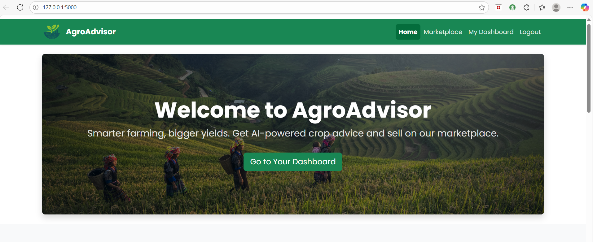
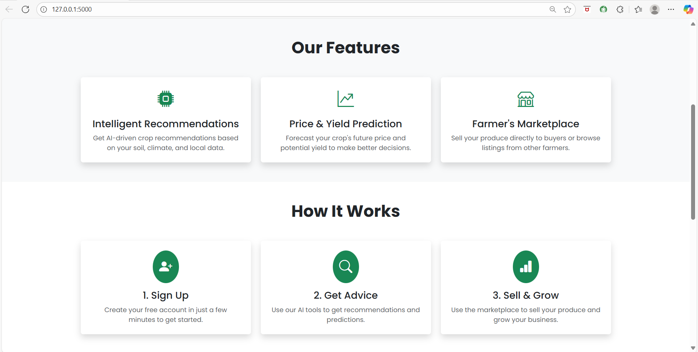

Slide 23
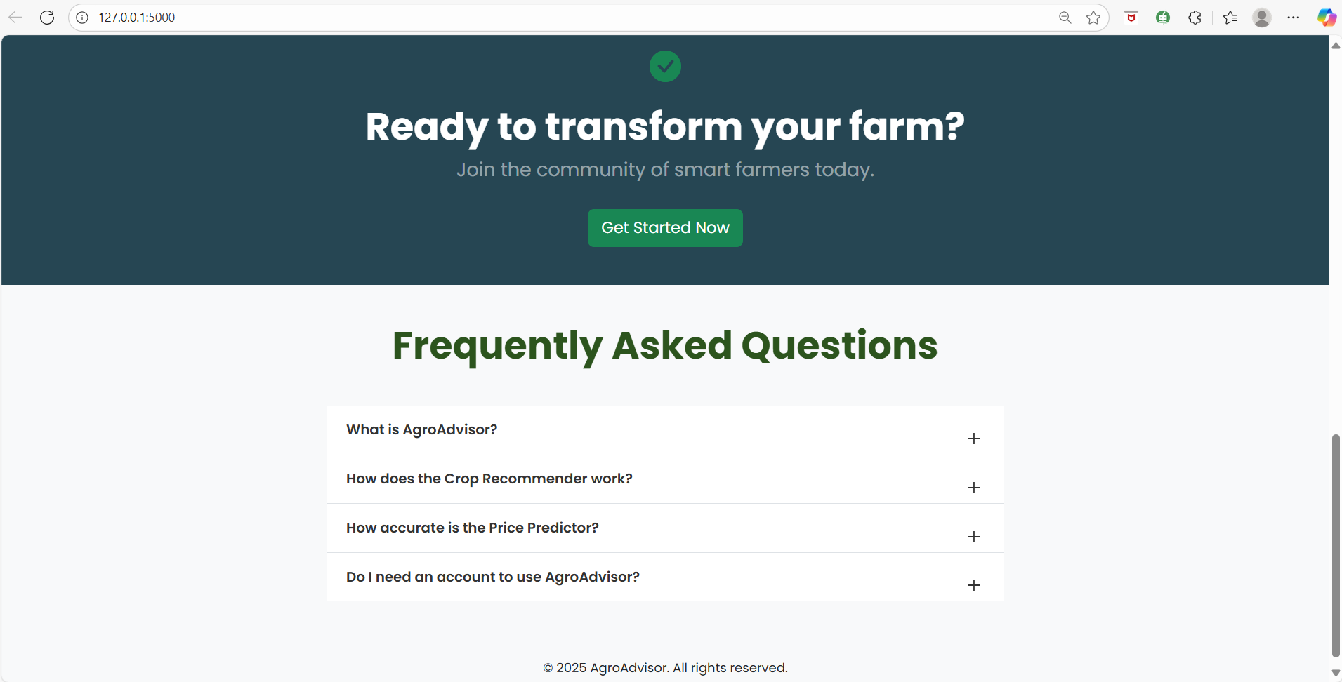
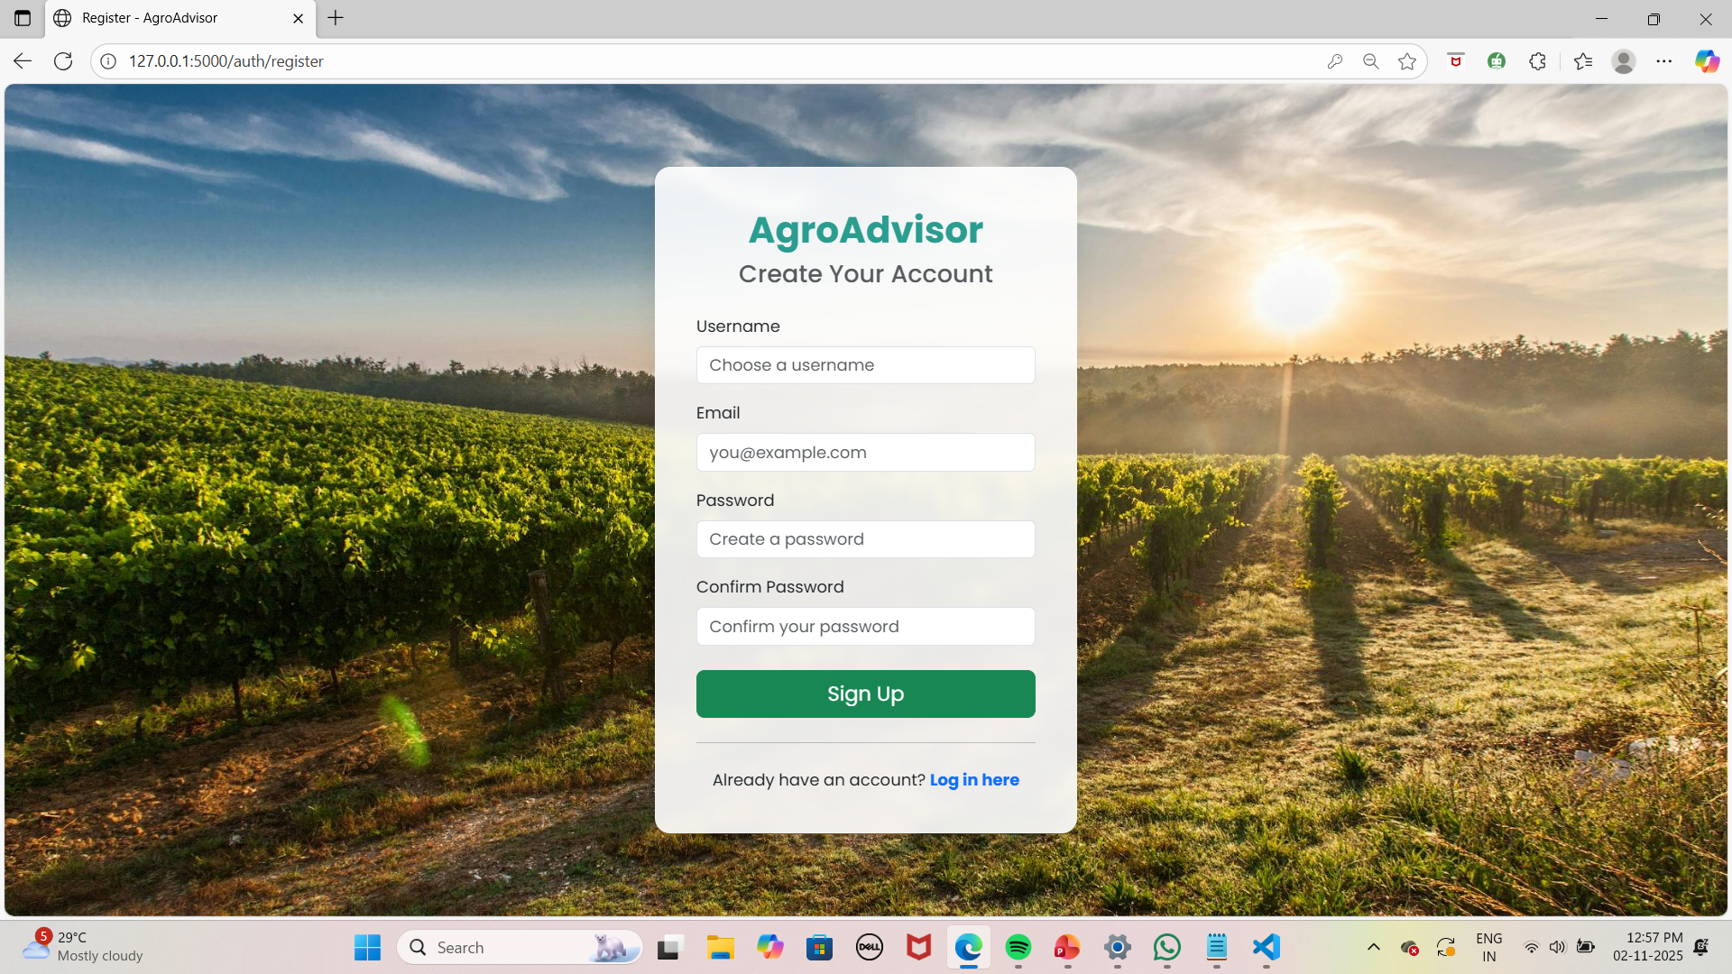

Slide 24
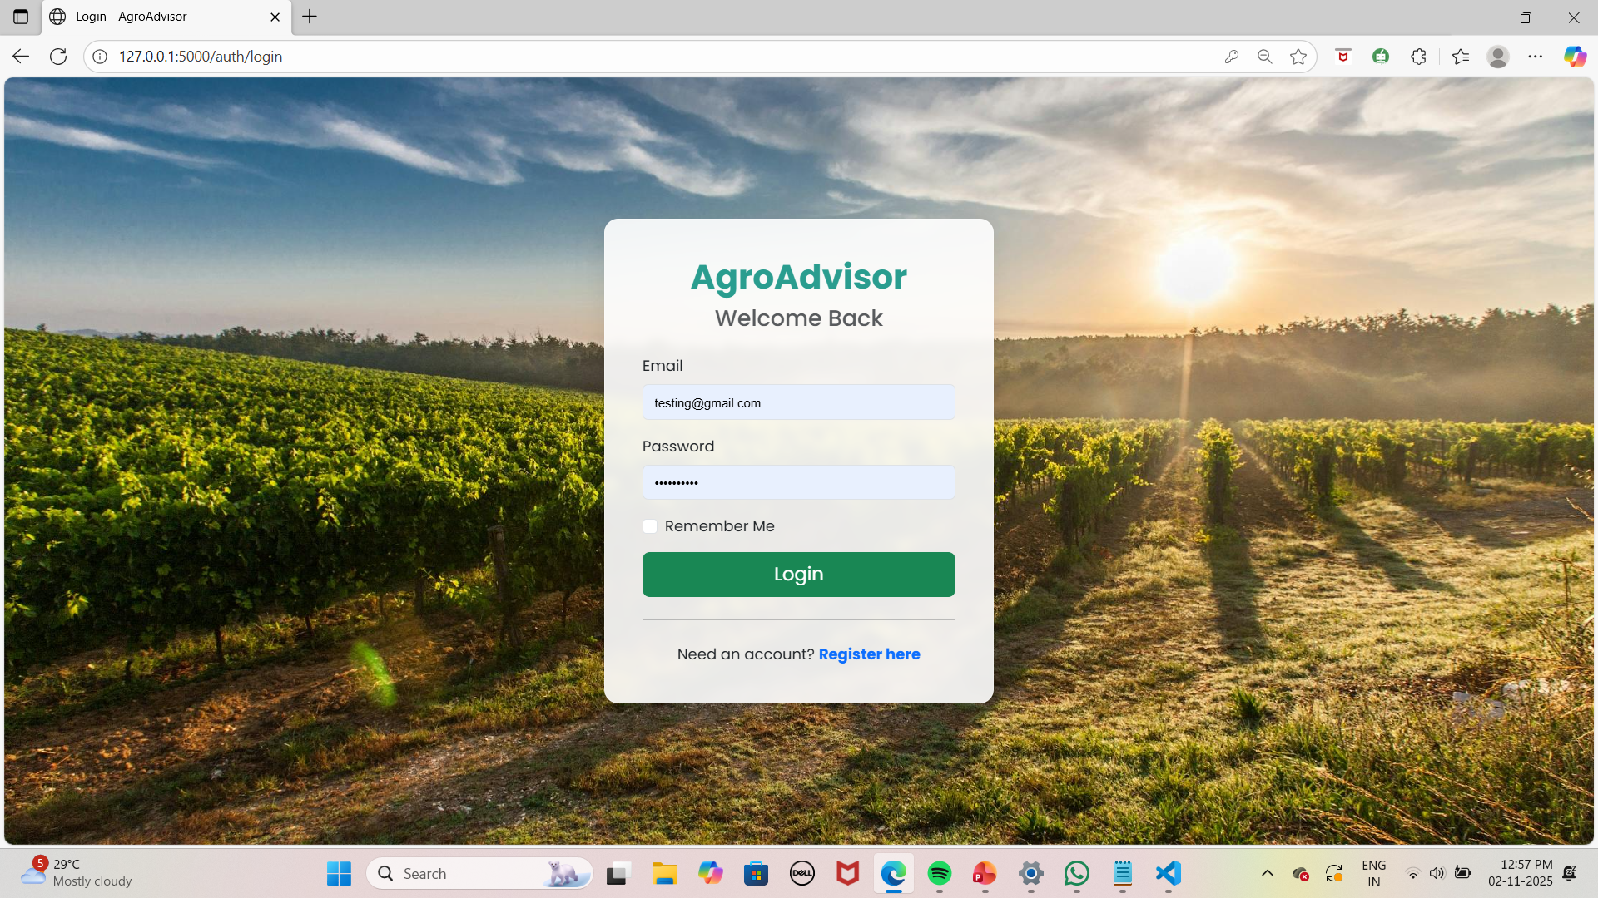
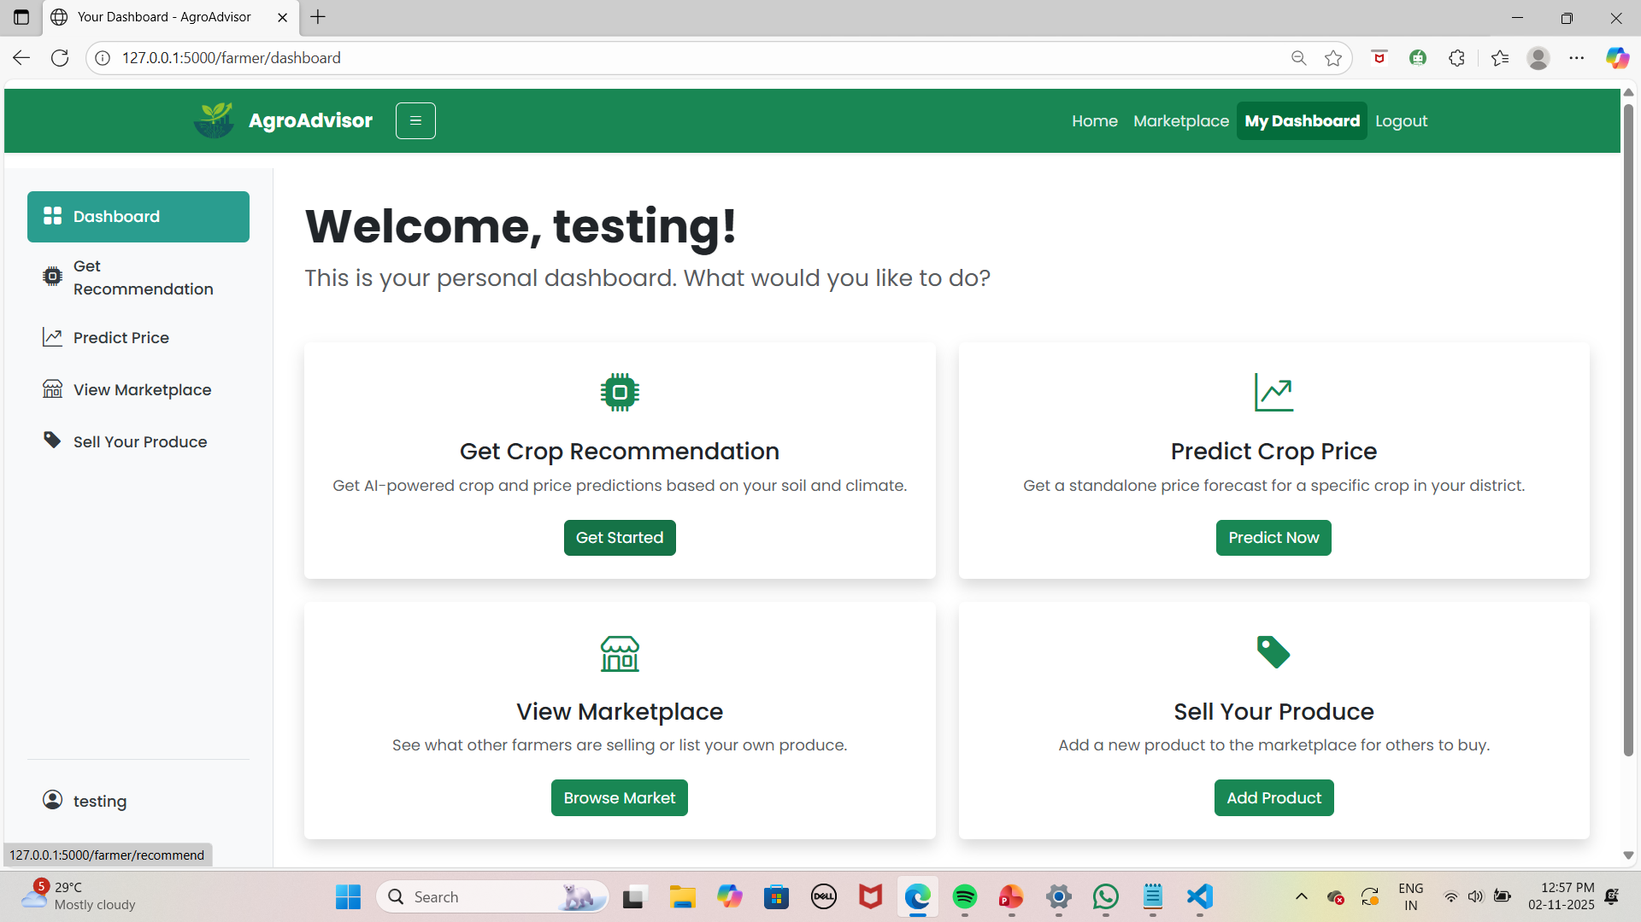

Slide 25
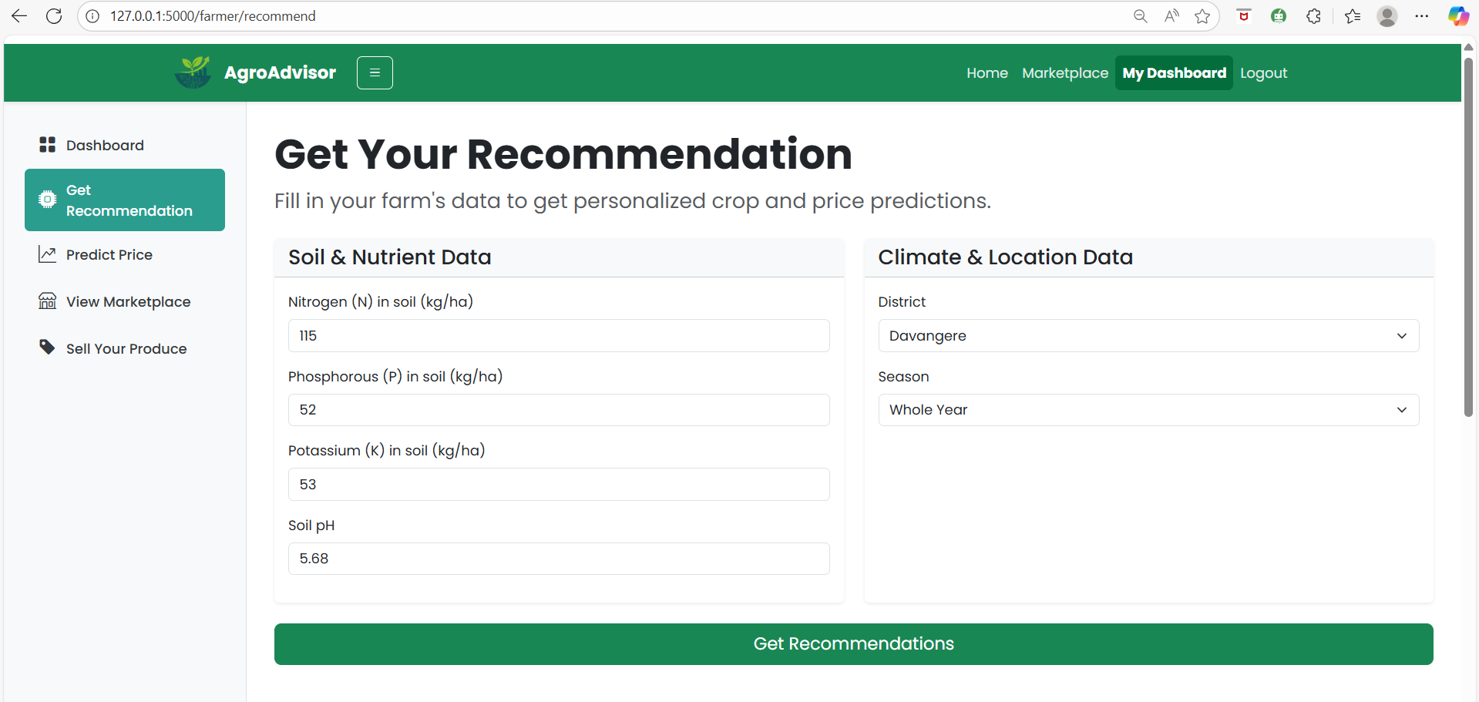
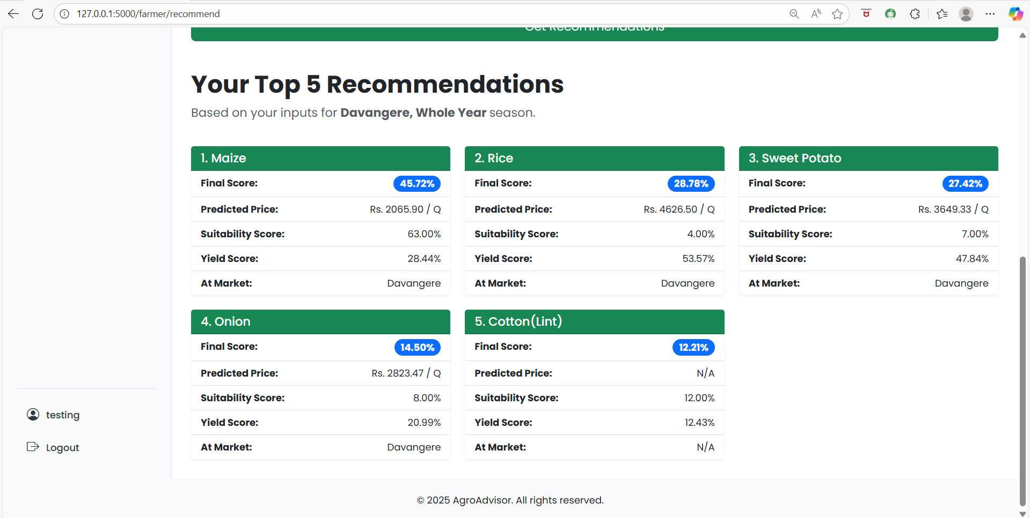

Slide 26
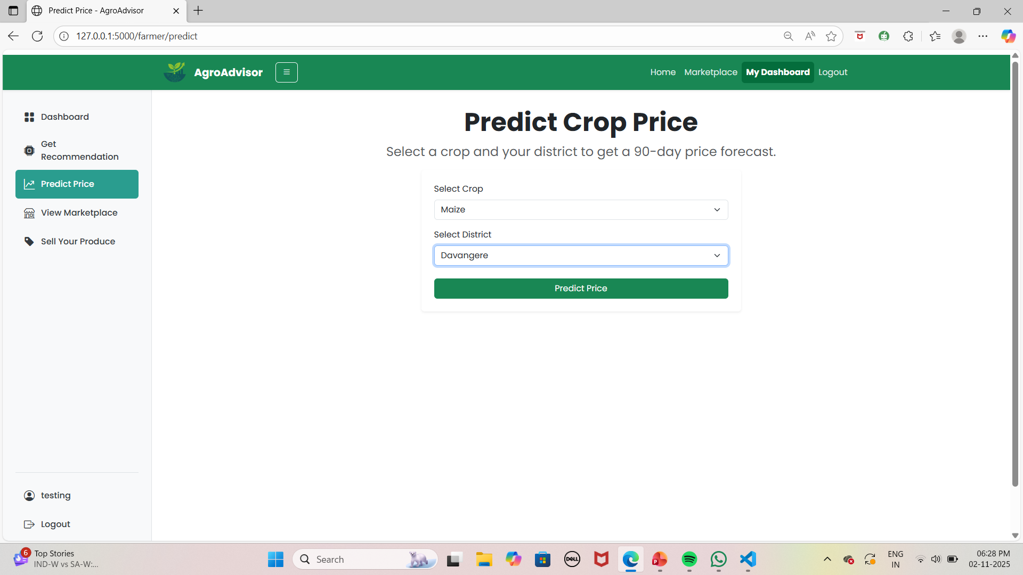
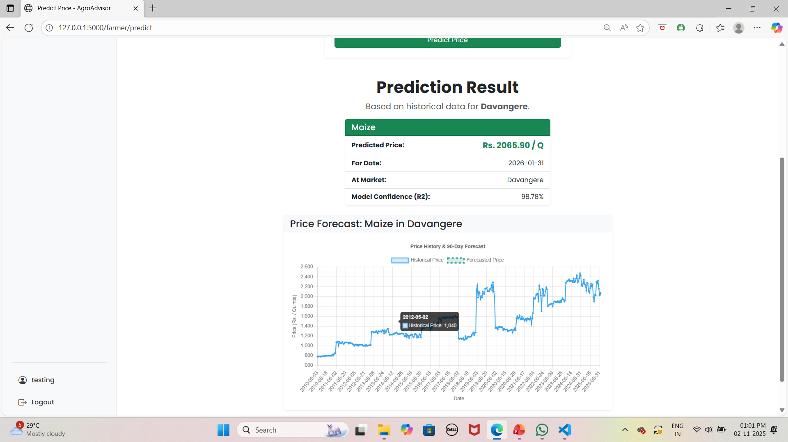

Slide 27
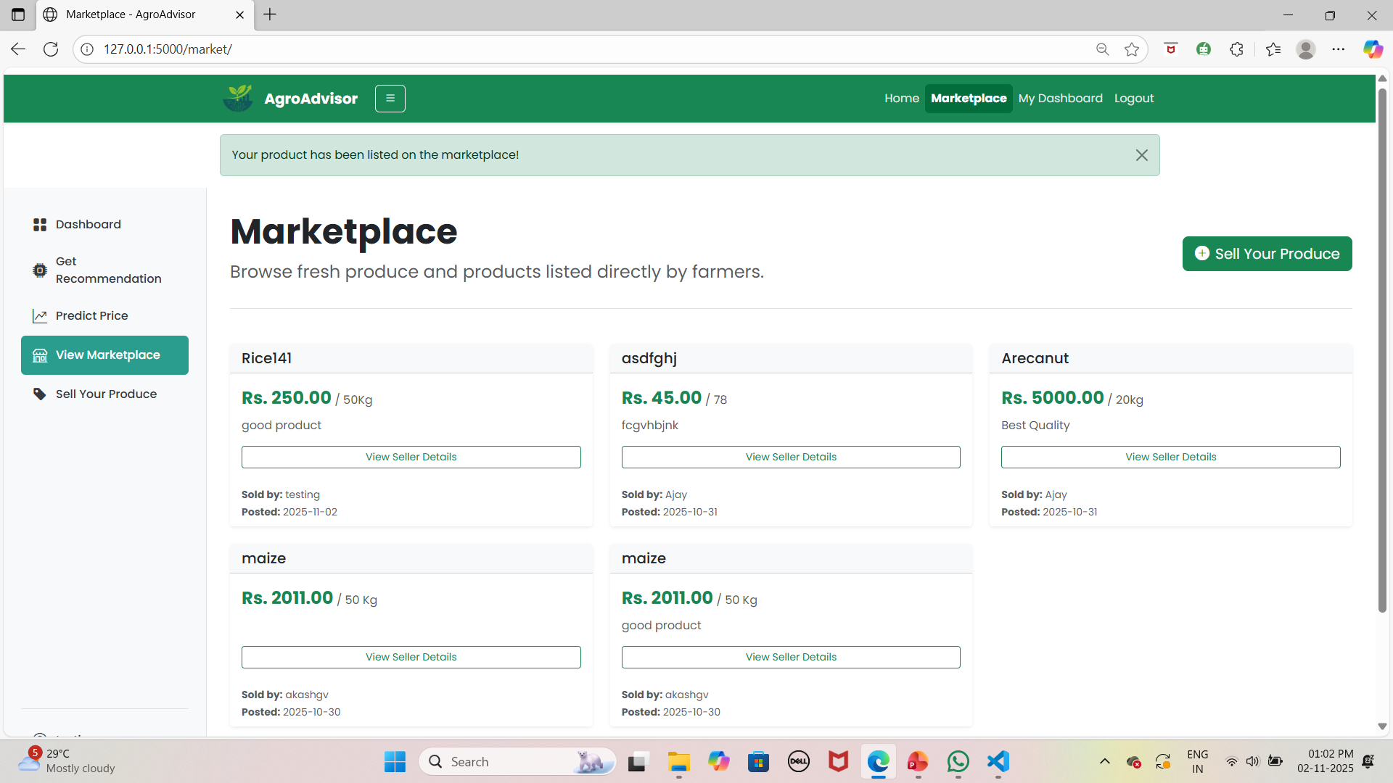

Slide 28
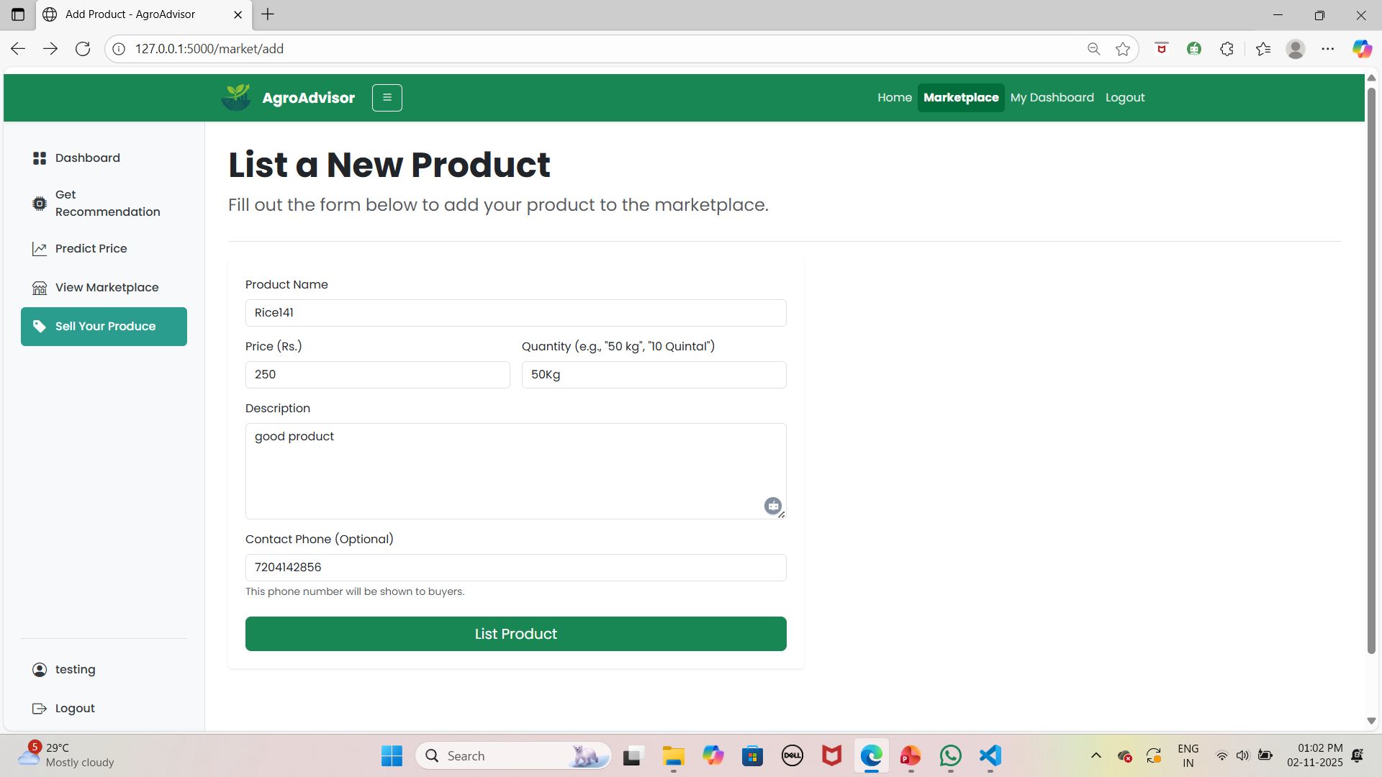
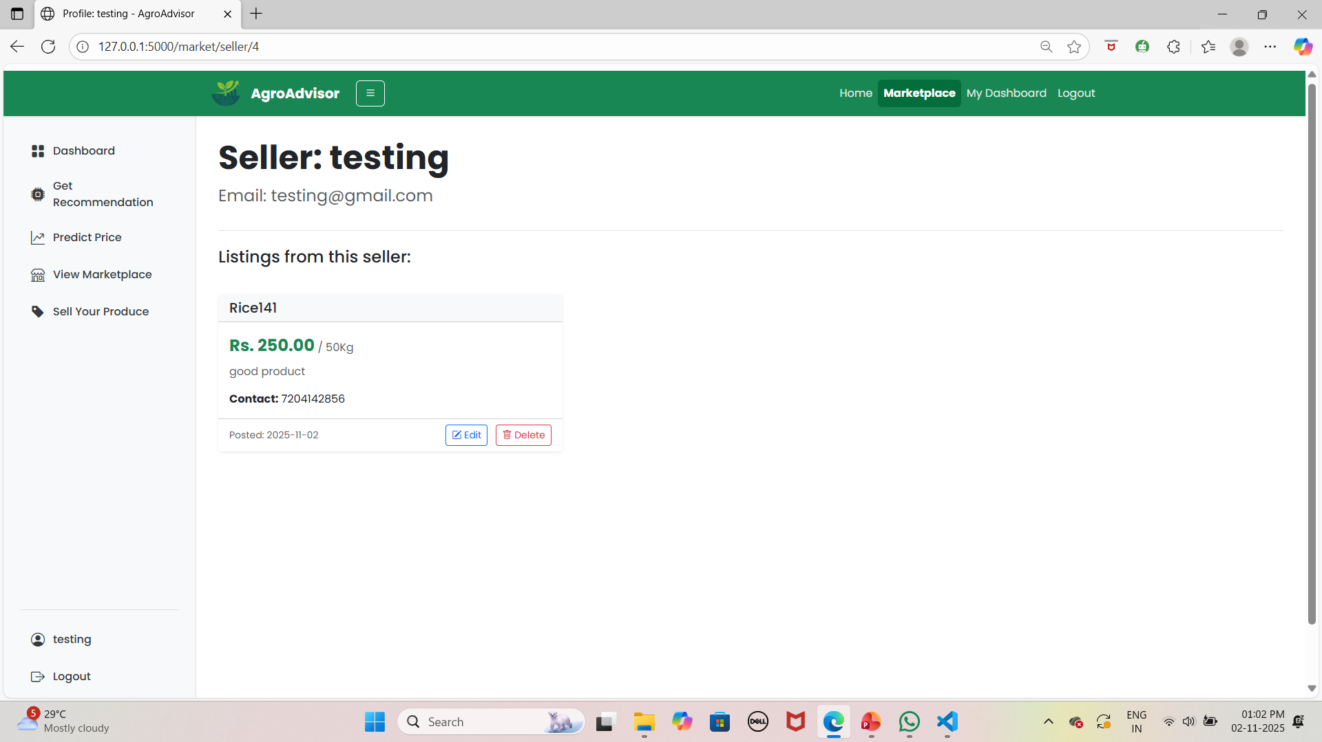

Slide 29
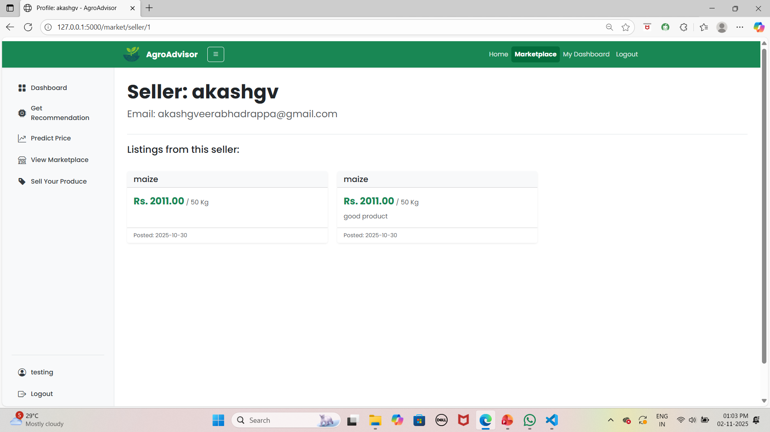

Slide 30
Advantages
Gives 3-in-1 advice: Crop, Price, and Yield.
Easy-to-use dashboard for farmers.
Includes a Marketplace to sell produce directly.
Helps farmers make data-driven, profitable decisions.
Disadvantages
Requires an internet connection to use.
Model accuracy depends on the training data.
Farmer must get their own soil (N, P, K) tested.
Predictions may only be accurate for trained regions

Slide 31
CONCLUSION
Accurate Crop Price Forecasting: Developed machine learning models to predict future crop prices using historical market data and seasonal trends. This helps farmers make better market timing decisions.
Soil-Based Crop Recommendation: Implemented a recommendation system that suggests suitable crops based on soil fertility and regional environmental conditions.
Risk Mitigation in Farming: Reduced the chances of crop failure and financial loss by helping farmers choose optimal crops and sowing times.
3-in-1 ML System: Successfully developed and integrated three ML models for Crop Recommendation, Price Forecasting, and Yield Prediction.
User-Friendly Web Platform: Built an easy-to-use web app for farmers to access predictions and recommendations.

Slide 32
FUTURE ENHANCEMENT
Mobile Application: Develop a native Android/iOS app to make the system more accessible to farmers in the field.
Live Weather API Integration: Instead of just historical data, pull live weather forecasts to give even more accurate, short-term crop advice.
IoT Sensor Integration: Allow the app to connect directly with IoT NPK and pH sensors for real-time, automatic soil data entry.
Pest & Fertilizer Recommendation: Expand the ML models to also recommend specific fertilizers based on soil deficits and warn about common pests for the recommended crop.
Marketplace Upgrades: Enhance the marketplace with user ratings, chat, and location-based search to make it a fully functional trading platform.
Automatic Model Retraining: Build an admin feature to automatically retrain the ML models with the latest market and weather data to keep predictions accurate

Slide 33
References
Data Sources:
Agmarknet (Government of India). https://agmarknet.gov.in (Used for historical market price data).
Open-Meteo. https://open-meteo.com (Used for historical weather data)
Core Technologies:
Flask. https://flask.palletsprojects.com/ (The Python web framework used to build the application).
Scikit-learn. https://scikit-learn.org/ (Python library used for all ML models: Random Forest, Gradient Boosting).
Flask-SQLAlchemy. https://flask-sqlalchemy.palletsprojects.com/ (Used for SQLite database integration, users, and marketplace products).
Pandas. https://pandas.pydata.org/ (Used for data manipulation and preparation for the ML models).

Slide 34
References
For Crop Recommendation (Random Forest):
M. S. Joshi, P. U. Shelke, P. S. Shinde, S. S. Sonawane, and S. S. Shirsath, “Crop Recommendation System Using Machine Learning,” International Research Journal of Engineering and Technology (IRJET), IRJET Publications, India, 2022, Volume 09, Issue 05, pp. 4136-4139
For Price Prediction (Gradient Boosting):
A. Wahdan, A. Selmy, and A. Farouk, “Crop Price Prediction using Machine Learning Techniques: A Comparative Study,” 2021 International Mobile, Intelligent, and Ubiquitous Computing Conference (MIUCC), 2021, pp. 293-298. (This paper specifically compares Gradient Boosting with other models for this task)

Slide 35
THANK YOU..!

